Slide 1
Embedded systems and IOT
1
Lab 1

Slide 2
LAB Requirements
2

Slide 3
Contents
3
Tools and Equipments
Passive Elements

Slide 4
[1] Tools and Equipments
4

Slide 5
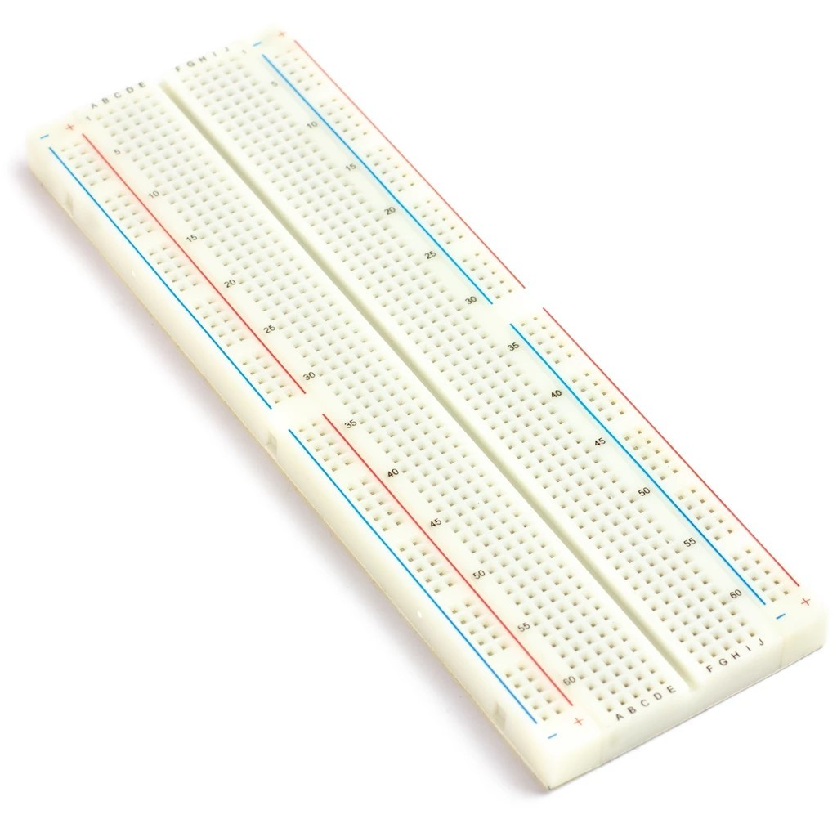
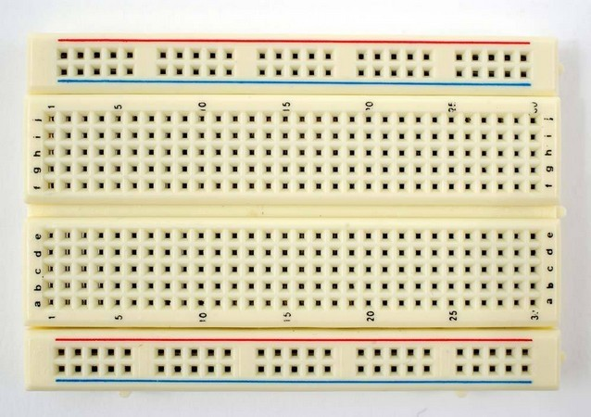
Breadboard (Sizes)
5

Slide 6
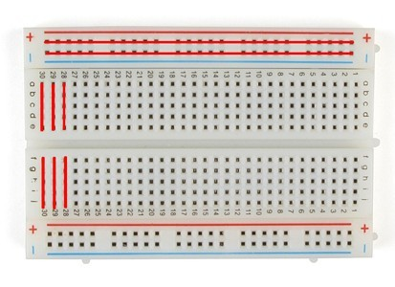
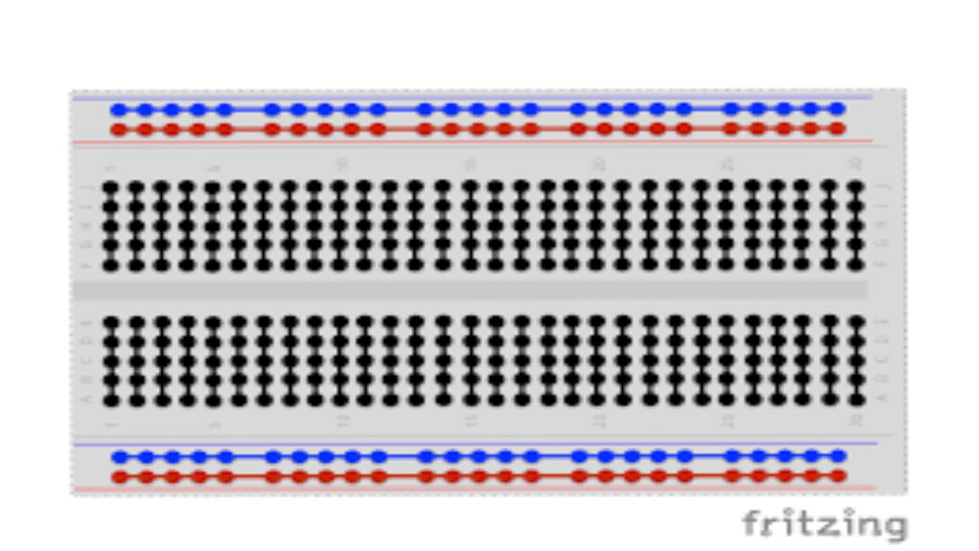
Breadboard (Connectivity)
6

Slide 7
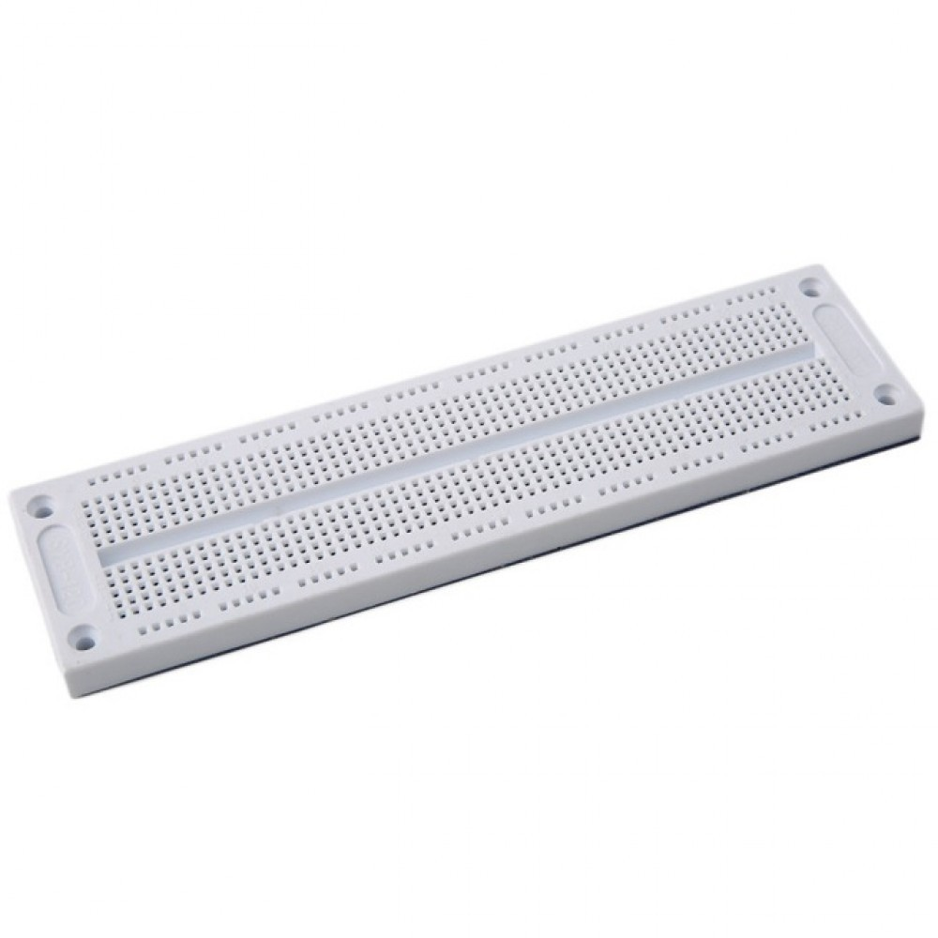
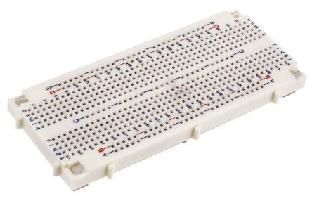
Breadboard (Expandability)
7
X

Slide 8
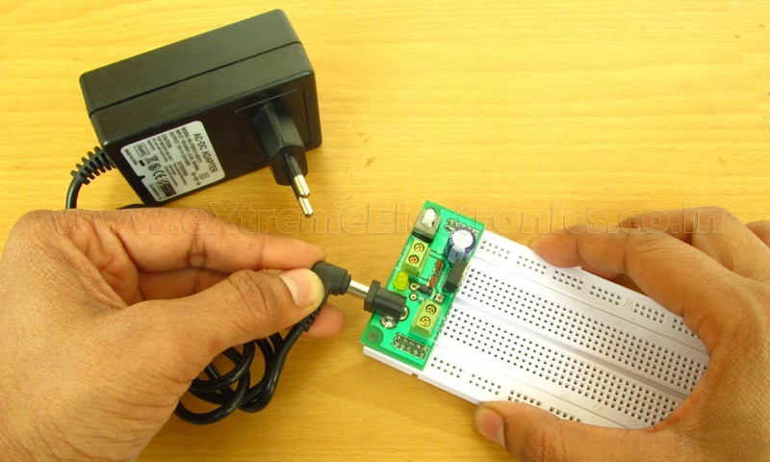
Breadboard (Power Connectivity)
8

Slide 9
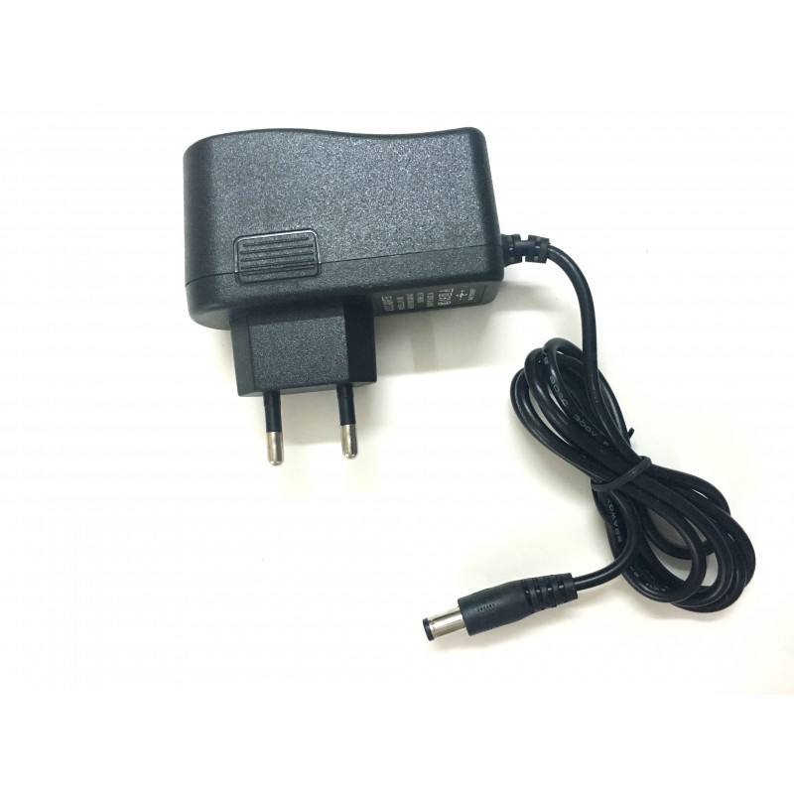
Power Adapter
(5 Volts – 5 Volts – 5 Volts )
9
Input: 220v
Output:
Volt: 5 Volts Current: Minimum 1A
Preferred 2 A

Slide 10
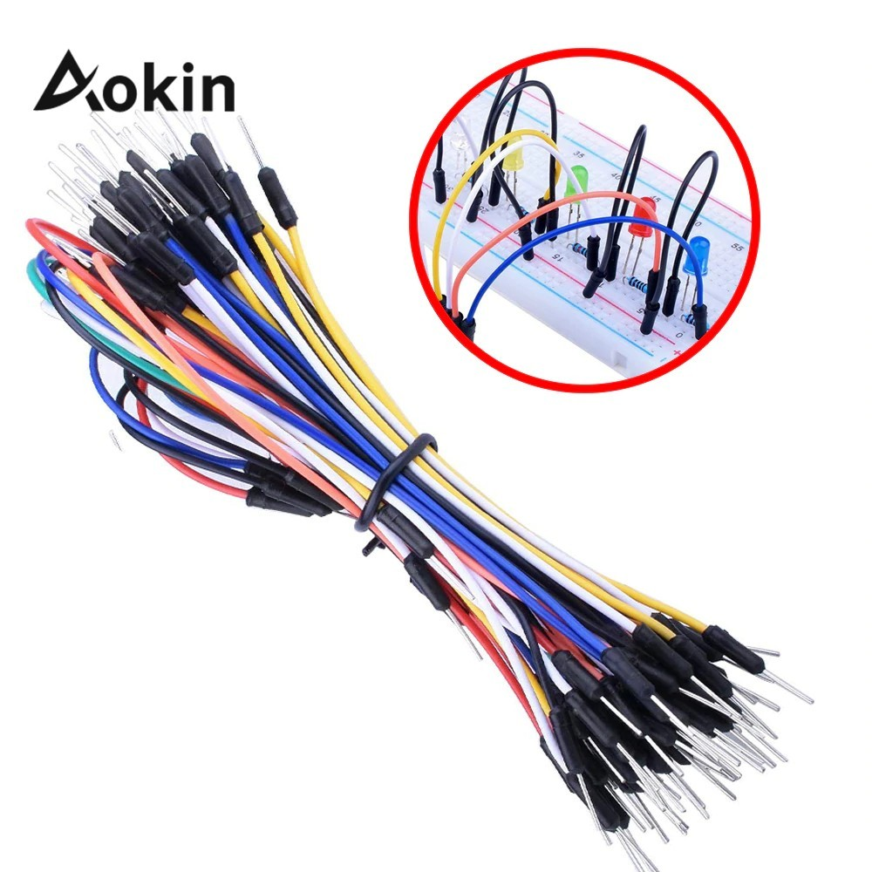
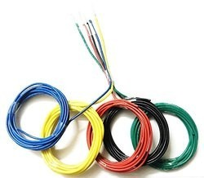
Breadboard Wires
10
Different Colors Different Sizes
May use regular long wires and cut suitable lengths

Slide 11
[2] Passive Elements
11

Slide 12
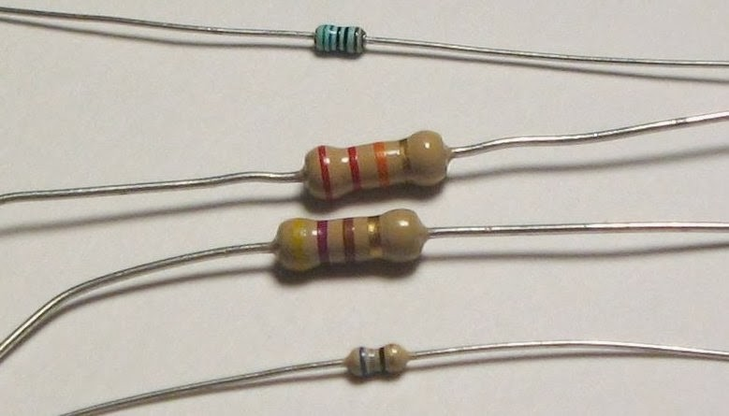
Fixed Resistors
12

Slide 13
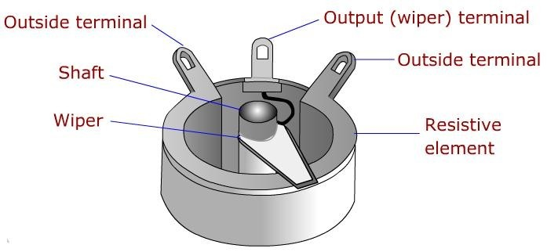
Variable Resistors
13

Slide 14
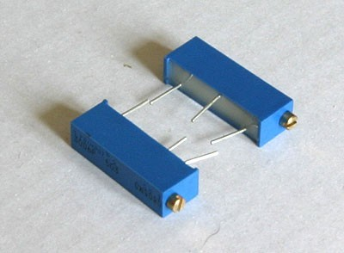
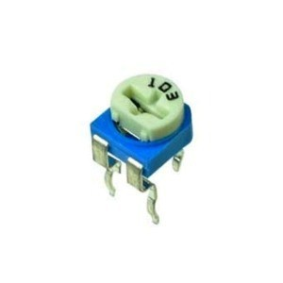
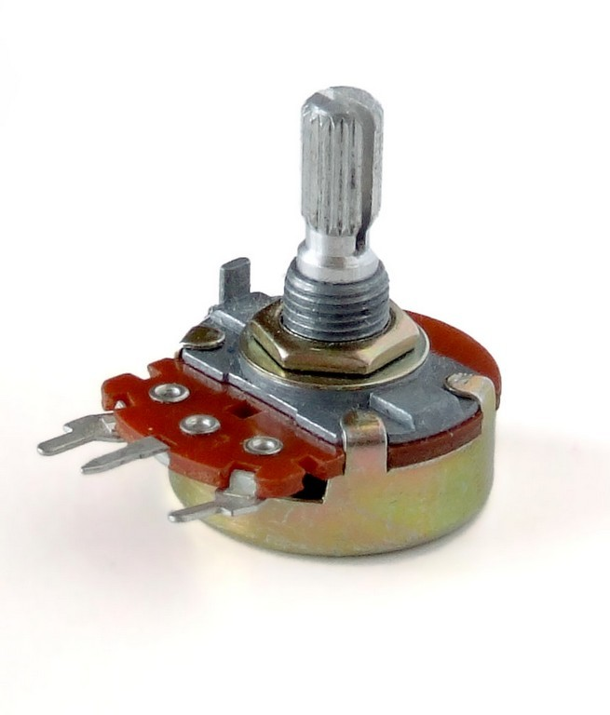
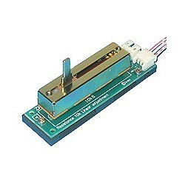
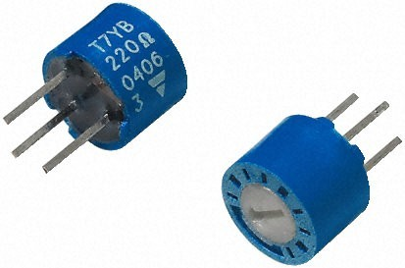
Variable Resistors
14

Slide 15
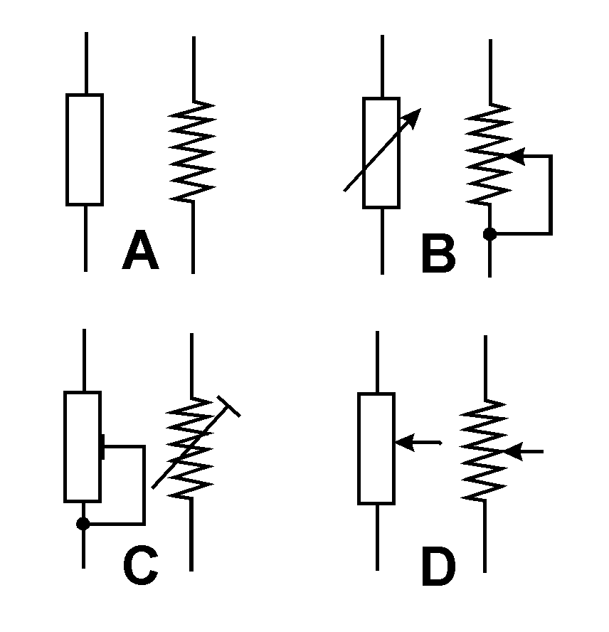
Resistors Symbols
15

Slide 16
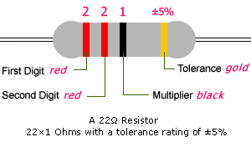
Resistors
16
0.9 "

Slide 17
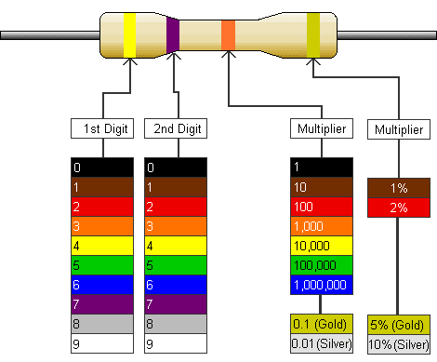
Resistors
4 7 000 =47K Ohm
17
+/- 5%

Slide 18
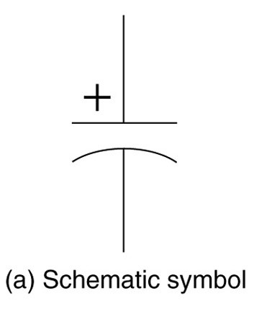
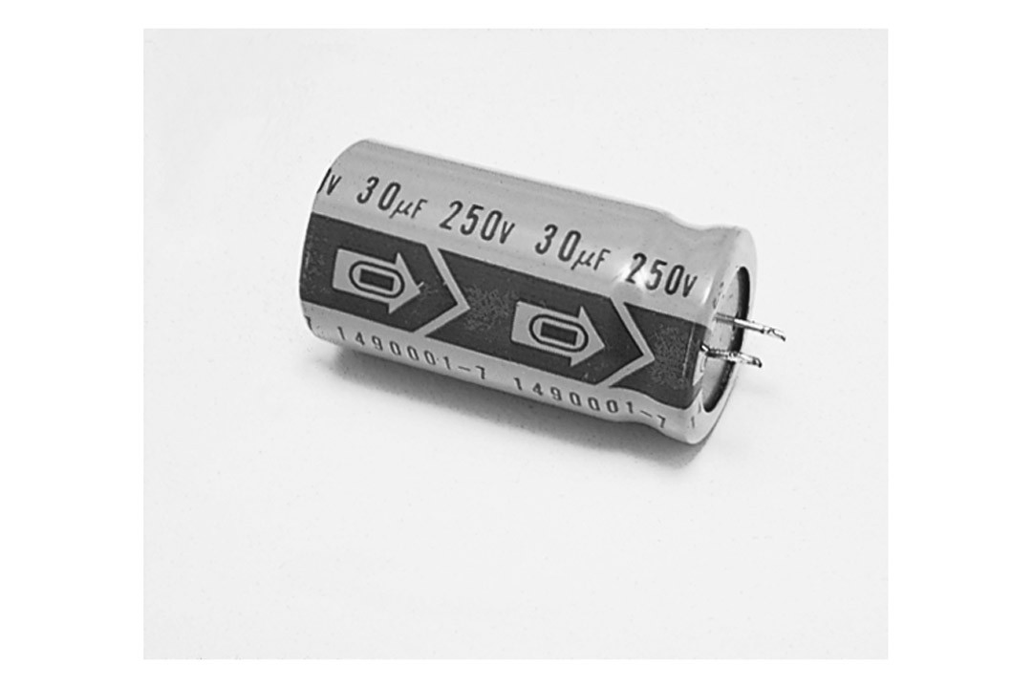
Fixed Value Capacitors
18
Polarized Electrolytic Capacitors
Most electrolytic capacitors are polarized
●
18

Slide 19
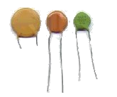
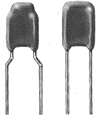
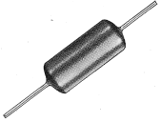
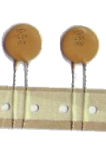
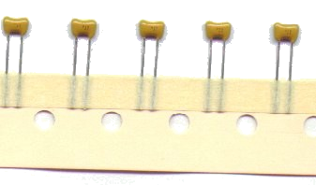
Styles - Appearance
19
Radial Leaded “Mono”
Axial Leaded “Mono”
Radial Leaded Ceramic Disc
Monolithic Multi-layer Ceramic (MLC)
Packaged on tape for auto insertion
19

Slide 20
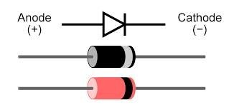
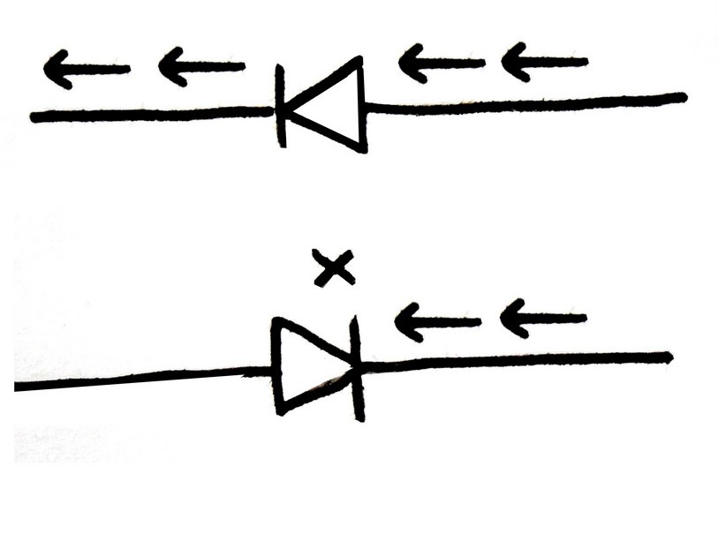
Diodes
20

Slide 21
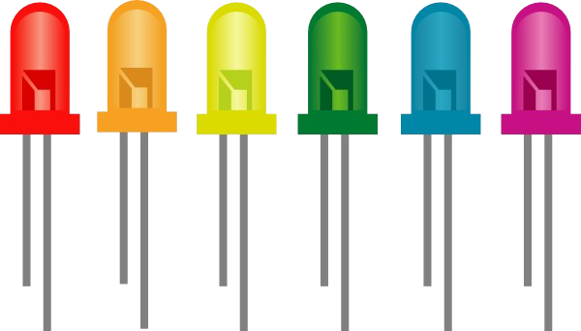
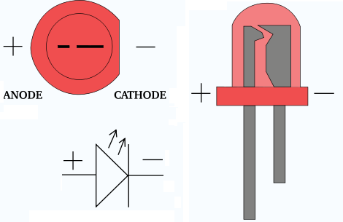
Light Emitting Diode (LED)
21
Warning:
LED Uses 3 Volts ONLY
Use small Resistance in Series with LED
220 Ohm
330 Ohm
470 Ohm

Slide 22
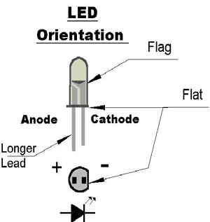
Light Emitting Diode (LED)
22

Slide 23
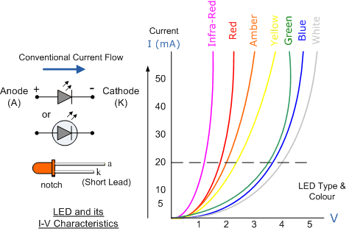
Light Emitting Diode (LED)
23

Slide 24
Thank you
2

